Slide 1
Leaf classification project
Convolutional neural network

Slide 2
OVERVIEW
This project is inspired by a plant leaf identification system created by Aayush Gupta (Link). Aayush Gupta used a machine learning model called Support Vector Machines(SVM) for building the system and the accuracy rate was 90.5%.
We will be using the same database but different model, a convolutional neural network model - VGG16 to improve the accuracy rate.
The database can be download from here. (Flavia leaves dataset)

Slide 3
dependencies
NUMPY
PANDAS
PIL
OS
REQUEST
LXML.HTNL
SHUTIL
SEABORN
MATPLOTLIB
CV2
SKIMAGE
RANDOM
KERAS
DATETIME

Slide 4
Process
1-Open and explore image dataset.
2-Extract labels and label the images.
3-Increase dataset by rotating images.
4-Split images to Train, validation and blind sets.
5-Convolutional neural network model building.
6-Data augmentation.
7-Train the model.
8-Result

Slide 5
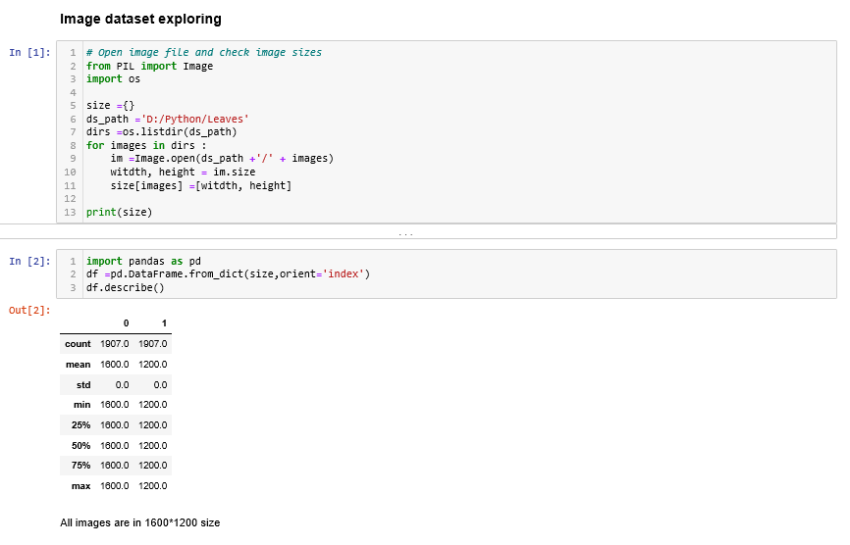
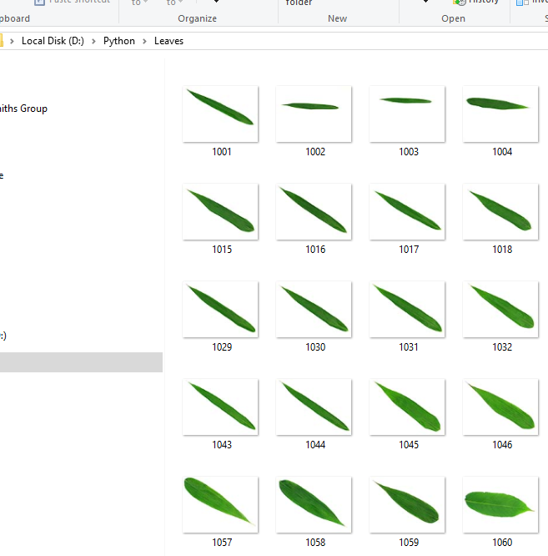
Open and explore image dataset
There are total 1907 images in the download folder and all images are in the same dimension1600x1200, but each image only have digit number as file name. There is no plant name labeled on the images.

Slide 6
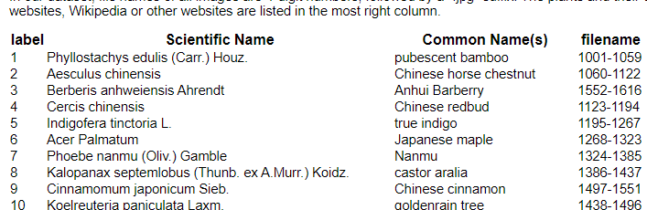
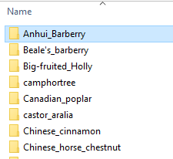
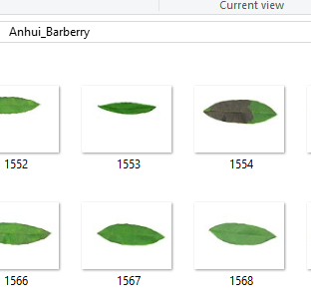
Extract labels and label the images
As we can see, the plant name is associated with a range of file number, hence if we create “Common names” folder for each plant and copy correspond images in to the folder, then we have labeled data.

Slide 7
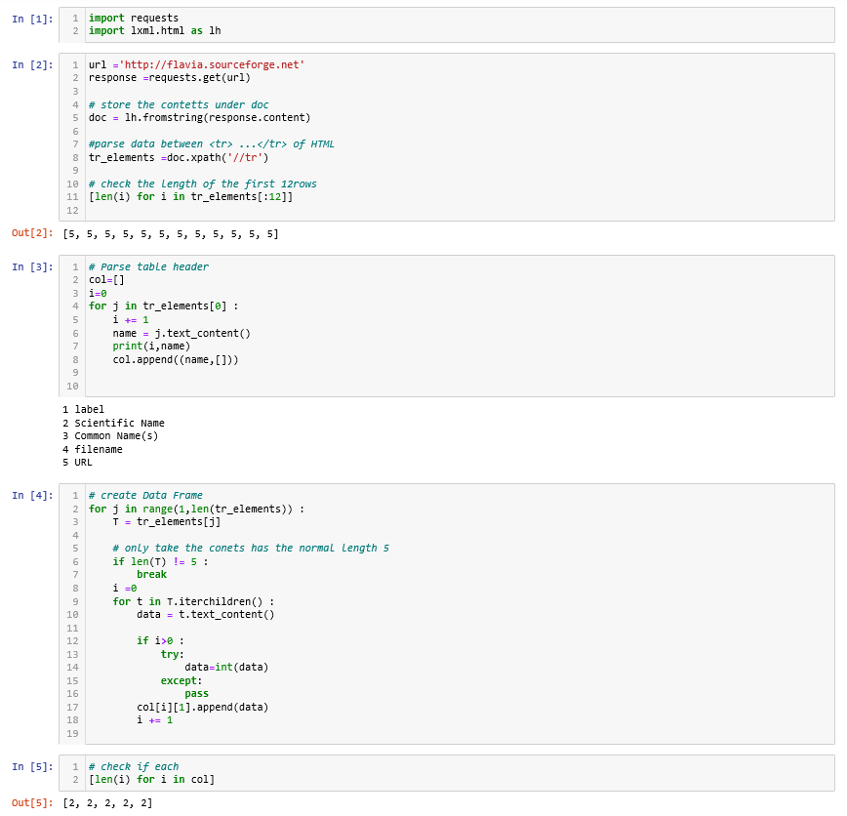
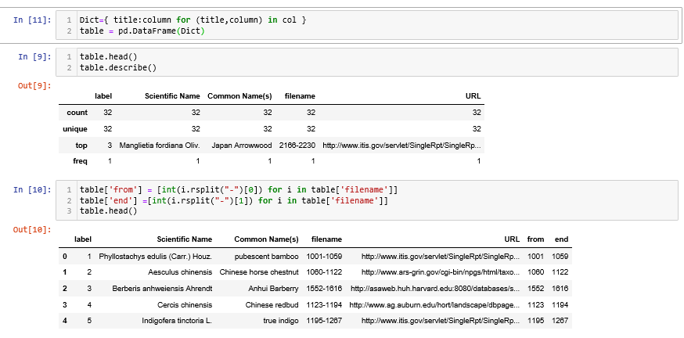
Extract labels and label the images
Used request and lxml.html to extract the plant name table from the dataset website and stored the table as a dataframe.

Slide 8
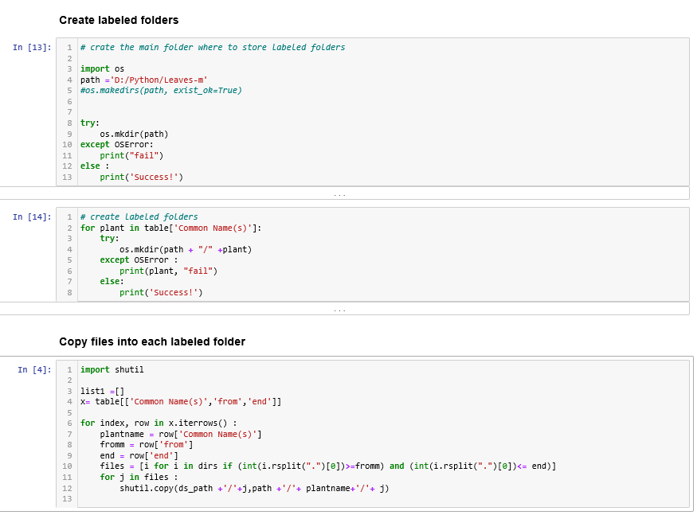

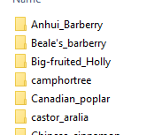
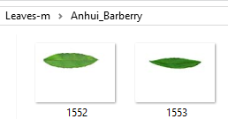
Extract labels and label the images

Slide 9
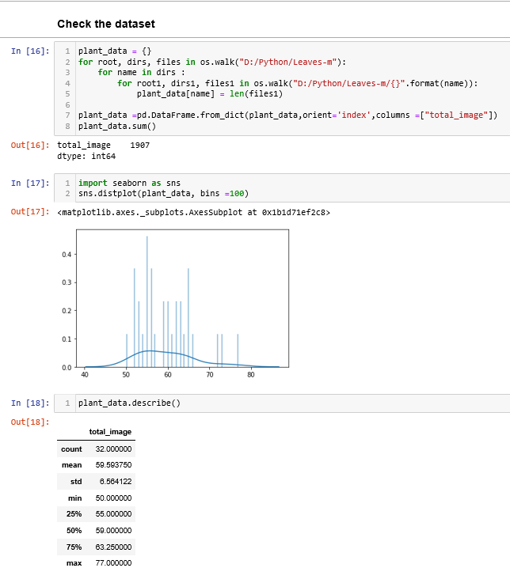
Extract labels and label the images
After labeling the images we can see we still have total 1907 images (good!)
Total class : 32
Average number of image by class : 59
Min number of image by class : 50
Max number of image by class : 77
Based on above information, we have quite small amount of data, as most of the articles I had read, it is referred to small data set when each class only have 800- 1000 images for CNN modeling.
I will need to create more data by rotating the images.

Slide 10
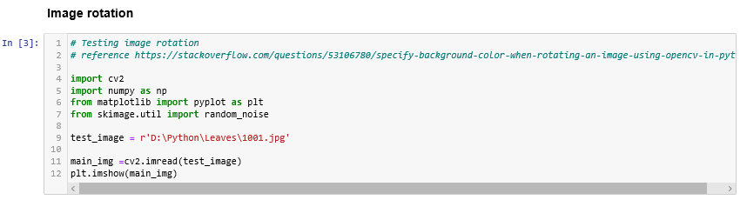
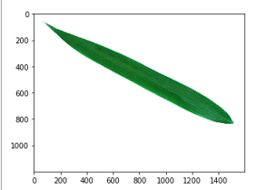
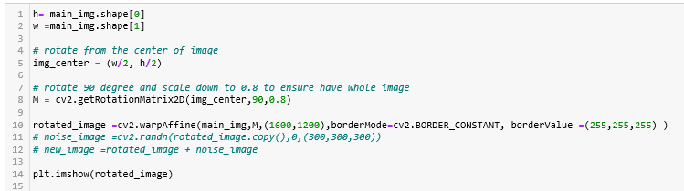
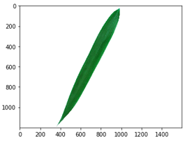
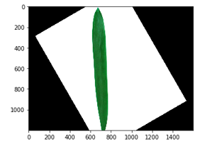

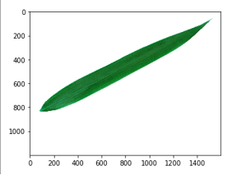
Increase dataset by rotating images
Set border constant and boader value to white helped to remove the block background

Slide 11
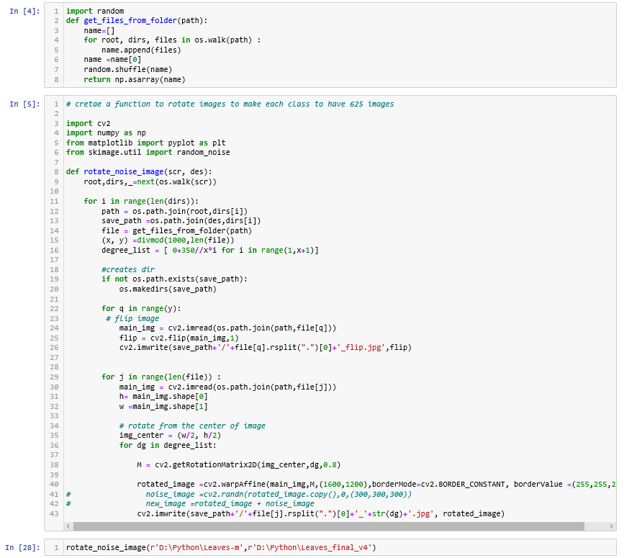
Increase dataset by rotating images

Slide 12
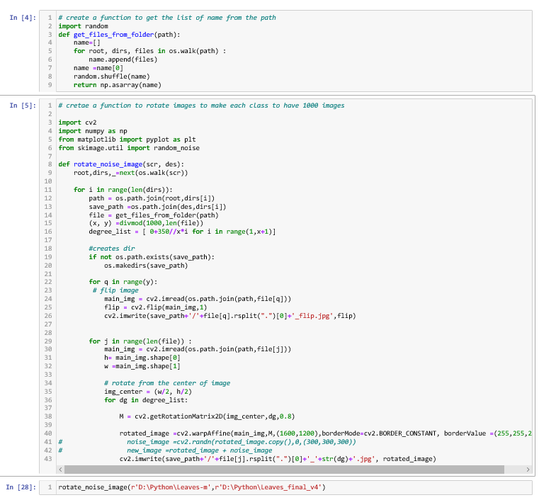
Increase dataset by rotating images
I set the goal to increase images numbers to 1000 for each class, so we can have enough data to train and also help balance each class.

Slide 13
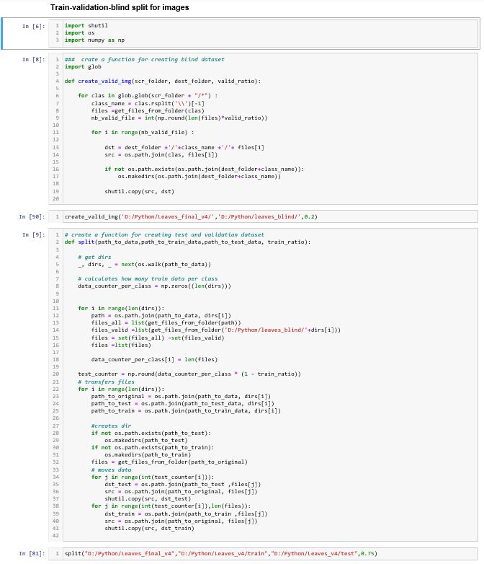
Split images to Train, validation and blind sets
I copied files to 3 folders, Train, test and split, as I wasn’t sure if there is a function to process train and split in CNN and for images. Later on I found out I might be able to do it in the fit model process. I will try it next time.
I now have 800 trains, 200 validation and 200 blind images for each class

Slide 14
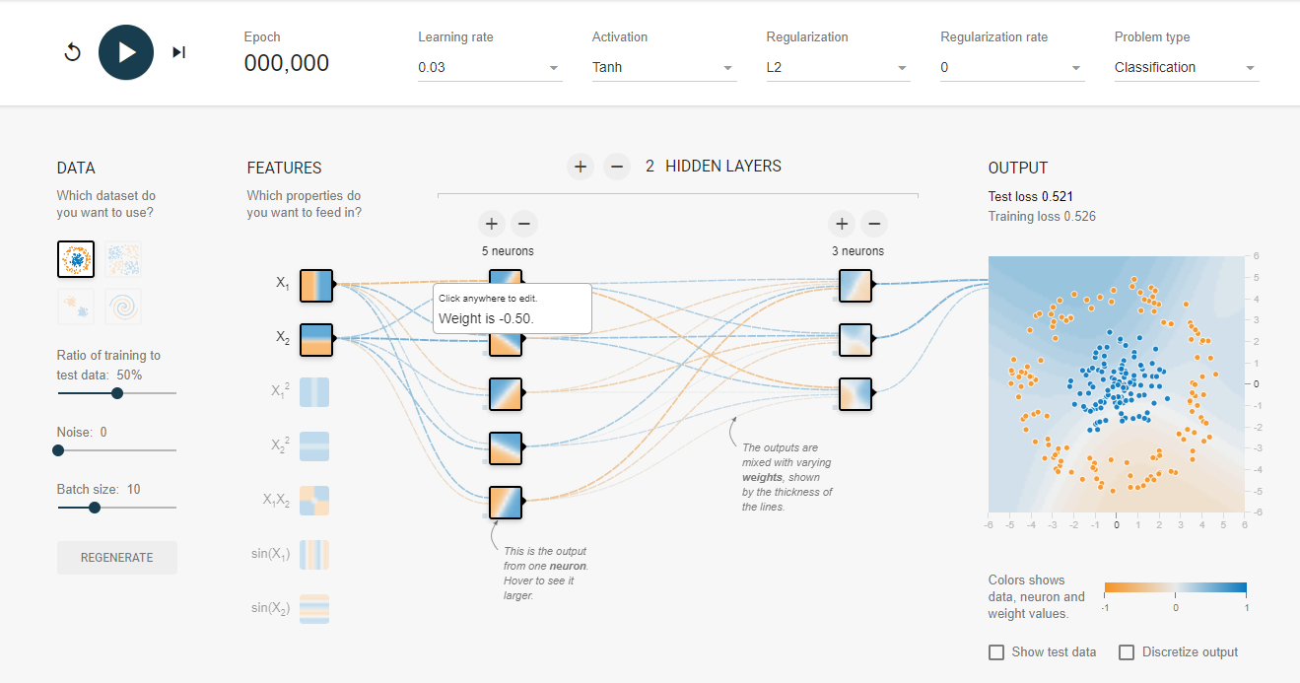
Convolutional neural network model building
Playground.tensorflow.org

Slide 15
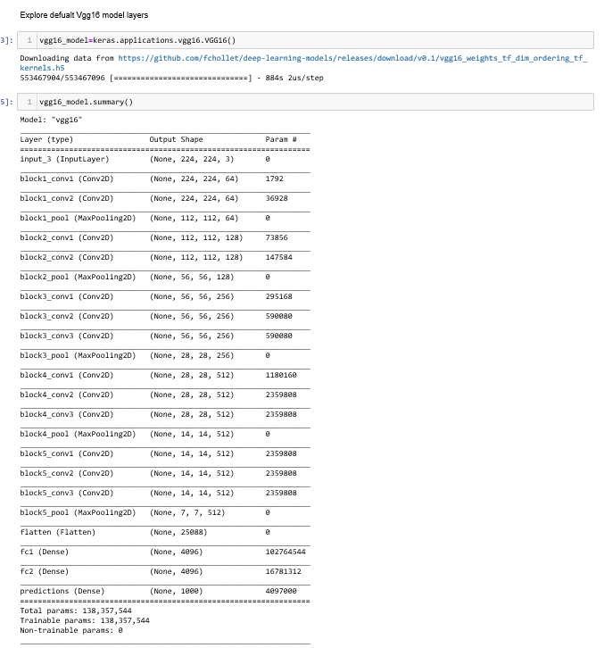
Convolutional neural network model building
First, we review the default structure of VGG16. There are total 5 block, 13 convolutional layers along with MaxPooling downsize the output following by 3 dense layers predict1000 classes.
Since I only have 32 classes to predict so I will drop the last 3 dense layer and feed my own layers to predict the plan. Also, compare to real world problem, 800 images per class is considered a small dataset, therefore I will leverage first 3 block as feature extractor and only update the weight on the last 2 block.

Slide 16
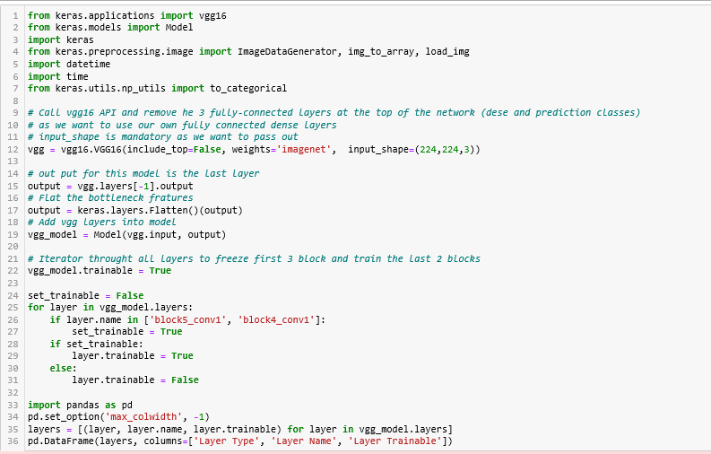
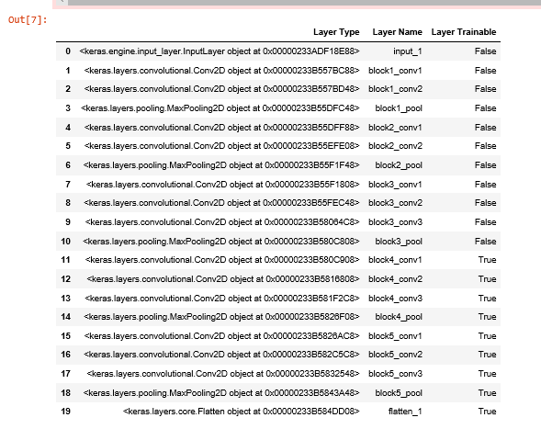
Convolutional neural network model building
Drop dense layers and freeze first 3 blocks.

Slide 17
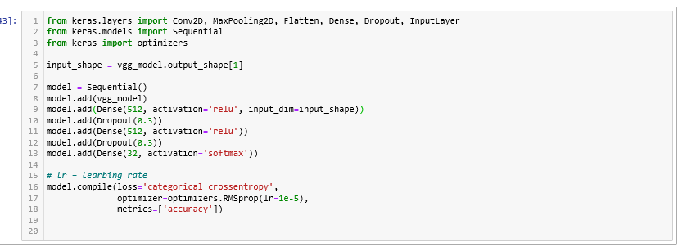
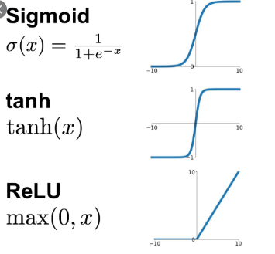
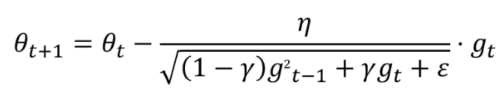
Convolutional neural network model building
As VGG16 is a deep learning API not a sequential function, so we need to feed VGG16 model we create to sequential model.
For the first 2 dense layer, I used “relu” activation as Sigmoid transform data between 0 to 1 and tanh convert data between -1 to 1. They both have limited sensitivity and might create vanishing gradient problem.
The reason of using SoftMax as the last prediction layer is because it is generate used in CNN last layers. It can take multiple variables and output a probability distribution

Slide 18
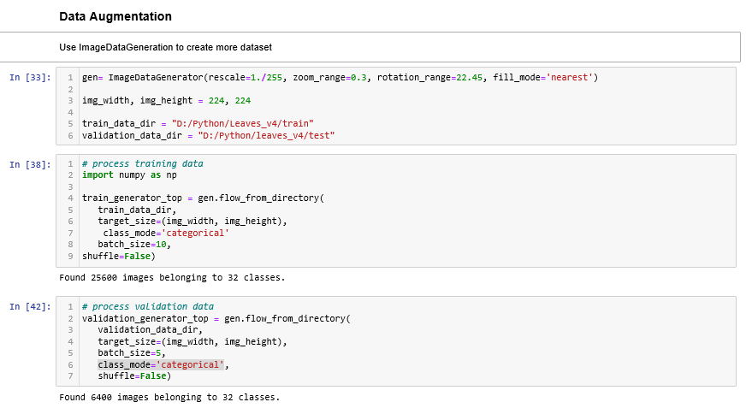


Data augmentation
In the ImageDataGenerator, I transformed the pixel to the range 0 to 1 and zoon/rotate images.
In the flow_from_directory function, it reads the images from the folders and generate batches of augmented data. (shape, labels)
For the batch size, I set 10 for train and 5 for validation as I am using my CPU computer. If I changed it to bigger batch size…..

Slide 19
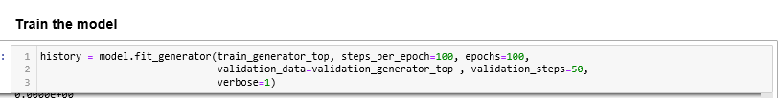
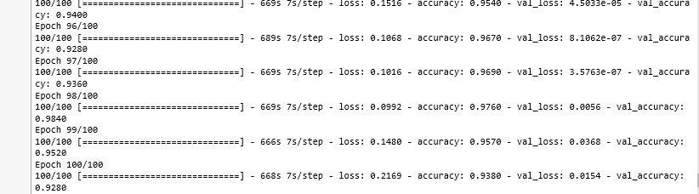
Train the model
Step_per_epoch means how many steps it need to run for each epoch for all images. For instance, I have total 25,600 train images so 256 images are passed in one mini batch and 100 steps are required for 1 epoch

Slide 20
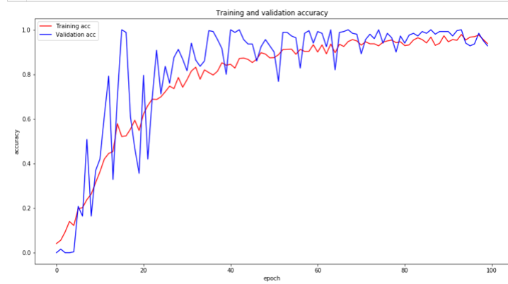
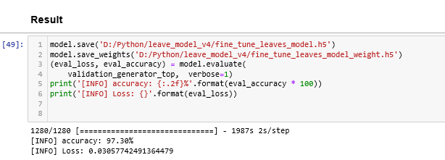
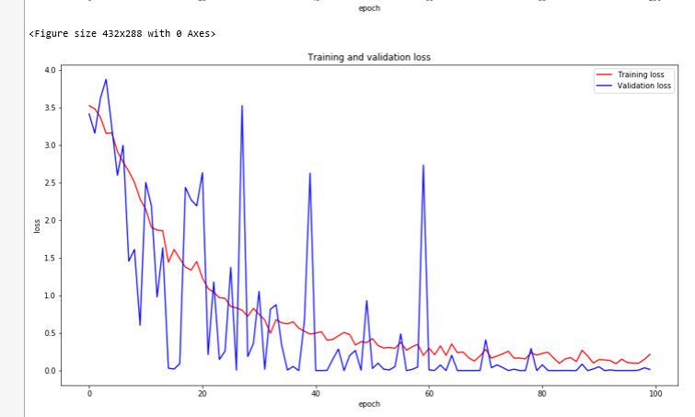
result
The accuracy result is at 97.30%.

Slide 21
Reference sources
Machine learning & Deep learning foundation : deeplizard youtuber
A Simple CNN: Multi Image Classifier
A Comprehensive Hands-on Guide to Transfer Learning with Real-World Applications in Deep Learning
The Keras Blog- How convolutional neural networks see the world
Keras ImageDataGenerator | Keras Data Augmentation | Create image dataset for CNN Deep Learning
Neural Networks and deep learning
Keras Documentation

